Slide 1
Understanding and Predicting Personal Navigation
Date : 2012/4/16
Source : WSDM 11
Speaker : Chiu, I- Chih
Advisor : Dr. Koh Jia-ling

Slide 2
Index
Introduction
Query Logs
General Navigation
Personal Navigation
Analysis
Conclusion

Slide 3
Introduction
One common way that Web search engines are used is to navigate to particular information resources.
Over 25% of all queries are navigational in nature.
Search book name
Query:amazon
Buy a book

Slide 4
Introduction
All queries in nature
Navigational
To reach a particular site.
E.g. : Youtube , Facebook .
Informational
To acquire some information assumed to be present on one or more web pages.
E.g. : car , house .
Transactional
To perform some web-mediated activity.
E.g. : price of goods , speed of service.

Slide 5
Introduction
Several approaches have been explored to identify navigational queries.
Analysis of the query string
e.g. : Is the query a URL or company name?
Behavioral data
e.g. : Does everyone click on the same result after issuing the query?
WSDM 2011
wsdm
WSDM-FM radio station

Slide 6
Introduction
To truly understand whether a particular instance of query is navigational
Understanding the individual user’s intent when they issue it.
Approach : Personal Navigation
Query : wsdm
http://wsdm2011.org →twice
Next time
Query : wsdm
It can be expected to click on the same result.

Slide 7
Query Logs
To explore navigational behavior
Bing search engine
The logs
For each query, the sample contained information
When the query was issued.
Who issued it.
The URL and rank of any clicked results.
21 million users
70 million queries
Notes:
The sample was filtered to remove bots and spam

Slide 8
Query Logs
Users were associated with an anonymous ID stored in a browser cookie during their first search.
If a person has more than one computer, that person will have multiple IDs.
If more than one person uses the same account on a computer, they are amalgamated into a single user.
Become less useful over longer periods of time.
Query strings were normalized
Removing excess whitespace
Converting the text to lowercase
Removing punctuation

Slide 9

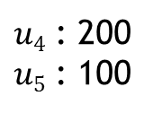
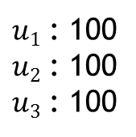
Identifying General Navigation
Looking for queries that were followed by everyone clicking the same result.
$pc(q)$ is the collection of URLs clicked on for query$q$.
$p\left(u|q\right)$ is the percentage of clicks on URL $u$ among all clicks for query $q$.
$q1$ →{$u1,u2,u3$} $q2$ →{$u4,u5$}
$u1$ : 100
$u2$ : 100
$u3$ : 100
$u4$ : 200
$u5$ : 100
$$CE\left(q\right)=−3\left(\frac{1}{3}∗log\frac{1}{3}\right)$$
$$=0.4771$$
$$CE\left(q\right)=−\left(\frac{2}{3}∗log\frac{2}{3}+\frac{1}{3}∗log\frac{1}{3}\right)$$
$$=0.2763$$
Notes:
We automatically identified a set of general navigational queries from the query logs

Slide 10
Identifying General Navigation
To identify queries with a click entropy lower than 1.00
Uncommon queries → have very low click entropy
Because the query has not been issued very often.
Having been issued by more than 10,000 distinct users.
Popular queries → have low click entropy
There is very few observed clicks for the query.
At least a total of 1000 search result clicks.
Notes:
because the query has not been issued very often.

Slide 11
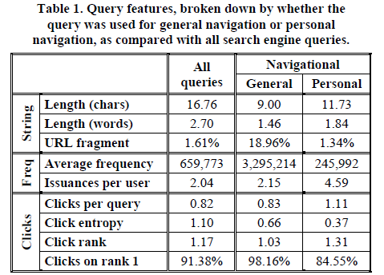
Understanding General Navigation
In this way we identified 390 unique general navigation queries.
The most common general navigational queries were facebook, youtube, and myspace.
Notes:
MySpace（中國版名稱：聚友）是一個社交網路服務網站，提供人際互動、使用者自定的朋友網路、個人檔案頁面、部落格、群組、照片、音樂和視訊影片的分享與存放。

Slide 12
Understanding General Navigation
Identifying navigational queries via aggregate query behavior is imperfect.
Miss many queries(high click entropy)
e.g. : weather.com and craigslist.
The corresponding homepage
Interior pages (e.g., 3.4% of all craigslist queries go to http://geo.craigslist.org/iso/us/ca)
Related pages (e.g., 17% of all queries for weather.com end up at http://weather.yahoo.com).
Notes:
because they had surprisingly high click
entropy, although they would have been considered navigational
via previous manual classifications

Slide 13
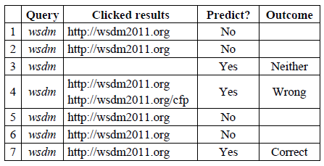
Identifying Personal Navigation
They find that repeat navigational behavior is very useful for identifying those queries that an individual uses over and over again to navigate to the same result.

Slide 14
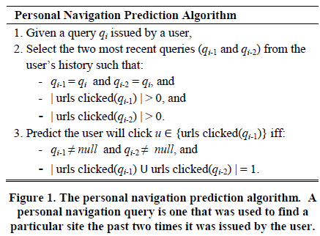
Identifying Personal Navigation
A detailed description of the algorithm used to identify personal navigation.

Slide 15
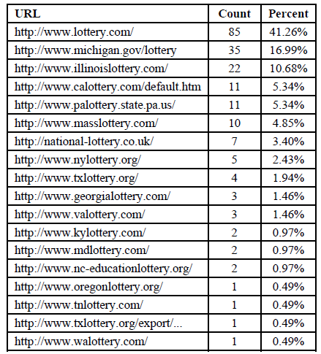
Analysis
An example of the different sites identified as the target of personal navigation for different individuals for the query lottery.
Notes:
it is not always obvious what the intended navigational target is merely from the query string.

Slide 16
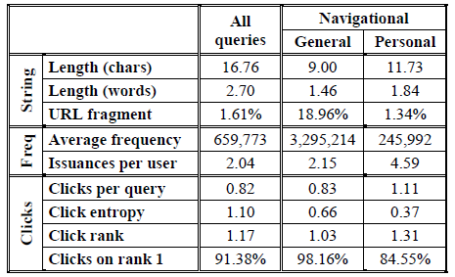
Analysis
It is not always obvious what the intended navigational target is merely from the query string.
For example,
Bed bugs
insect
http://www.medicinenet.com/
bed_bugs/article.htm

Slide 17
Coverage and Accuracy
Aggregation period length :
The period of user history used to initially identify personal navigation behavior.
Aggregation period start :
The day the aggregation period began.
Test period length :
The length of time during which personal navigation predictions were made.
Test period start :
The day the test period began.

Slide 18
Coverage and Accuracy
Coverage :
The total number of personal navigation predictions made divided by the total number of queries issued.
Accuracy :
The number of correct predictions made divided by the total number of correct or wrong predictions made.
Total test queries with clicks : 10000
Number of predictions : 4000
Good predictions : 3500
Bad predictions : 500
Coverage = 4000/10000 = 0.4
Accuracy = 3500/4000 = 0.875

Slide 19
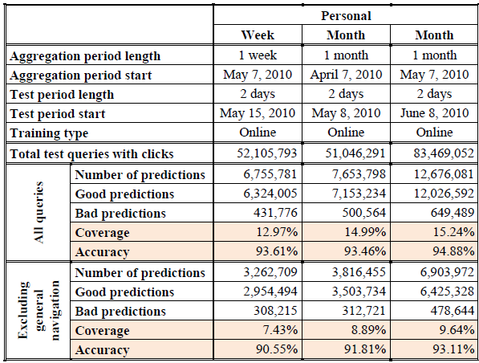
Coverage and Accuracy
Compared with General Navigation

Slide 20
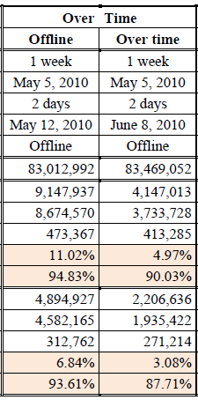
Consistency of Predictions over Time
Offline Predictions
Offline:
If the last two clicked query instances in the aggregation period resulted in the same single click, these two instances are used to predict what will be clicked in the test period.
Online:
Uses the most recent past two clicked query instances prior to prediction (from aggregation period or test period) to predict click in test period.
The personal navigation queries people use are ones they have been using for weeks.

Slide 21
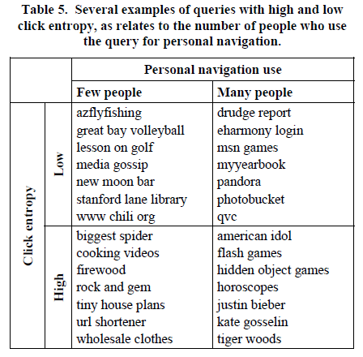
Individual and Group Navigation
Personal Navigation Varies by Individual

Slide 22
Individual and Group Navigation
Personal Navigation Consistent across Groups
To explore identifying personal navigation behavior across groups.
lacking personal history in initial algorithm.
General
+
Personal
Personal navigation
provide
Behavior

Slide 23
Conclusion
Demonstrated that there is a rich opportunity for straightforward search result personalization in support of personal navigation.
It is possible to identify general navigation queries and to thus know what people will click on for many queries a search engine sees.
Using an individual’s behavior to identify personal navigation allows for greater coverage and higher accuracy.

